Slide 1
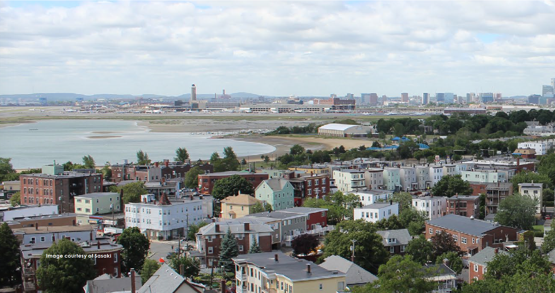
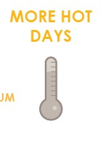
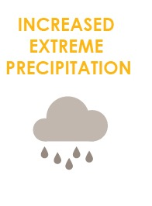
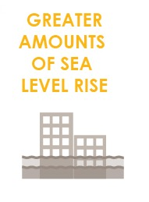
FOCUS AREA: EAST BOSTON
40,000+ people, 28,000 jobs, +$6 billion to city economy.

Slide 2
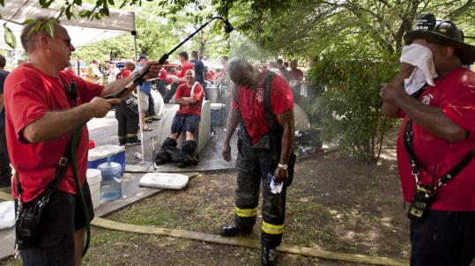
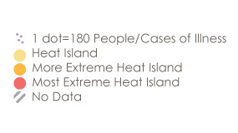
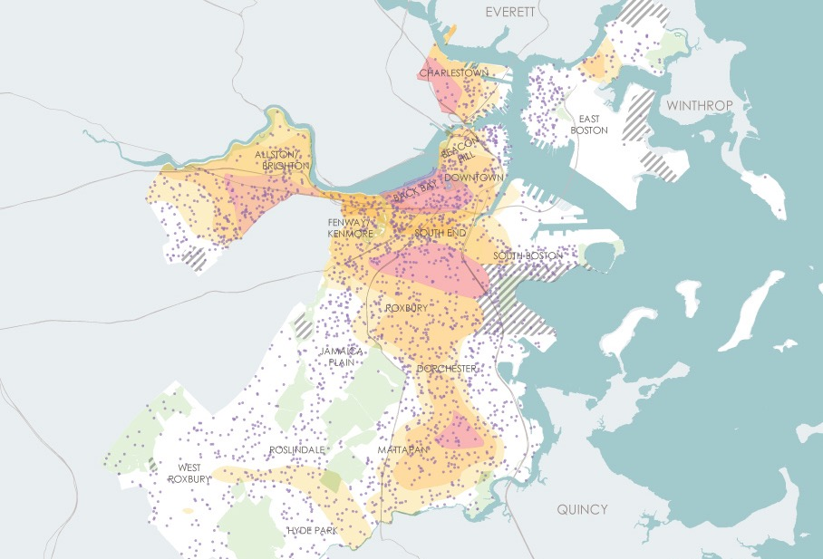
WHAT CLIMATE CHANGE MEANS FOR EAST BOSTON
More Hot Days
Medical Illness and Heat Island Exposure
Urban “heat islands” where there is less tree canopy are hotter and most at risk.
Some people are more vulnerable to heat than other such as those with illnesses or who are low income.
Notes:
Some areas more at risk than others due to heat urban island affect. Main point is that the parts of Boston that area already hotter than others due to low tree canopy
For East Boston – heat island not significant compared to other areas but still a concern given social vulnerabilities

Slide 3
WHAT CLIMATE CHANGE MEANS FOR EAST BOSTON
More Flooding
East Boston and South Boston have the most land area affected by coastal flooding and sea level rise.
East Boston also faces challenges from stormwater flooding.
Notes:
*East Boston and South Boston have the most land area affected by coastal flooding and sea level rise.
http://archive.boston.com/news/local/gallery/031510_your_storm_photos?pg=31
https://c.o0bg.com/rf/image_1920w/Boston/2011-2020/2016/01/25/BostonGlobe.com/National/Images/3fb314c6-c53a-4baf-938d-9e3535395264.jpg

Slide 4
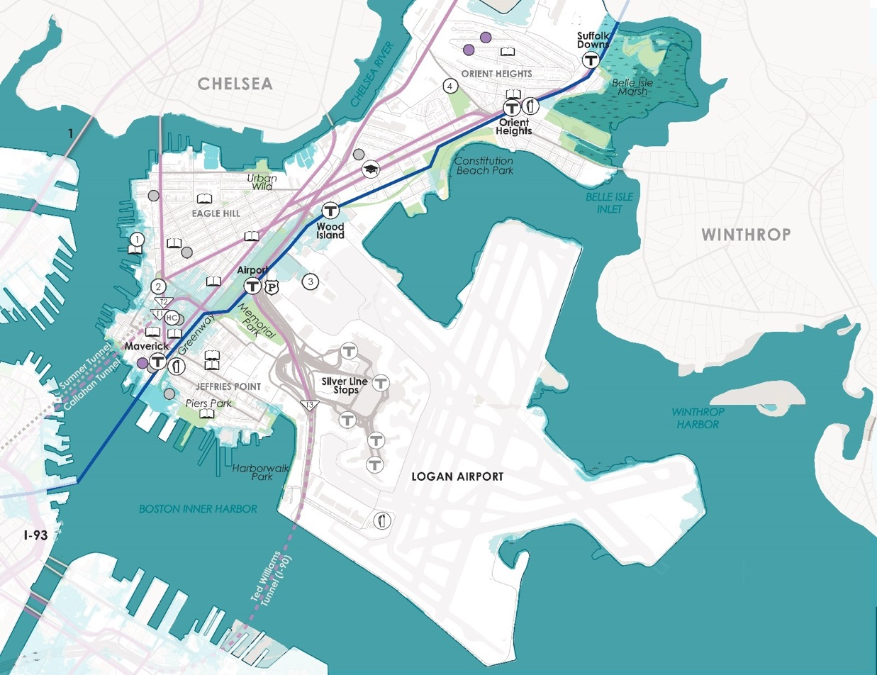
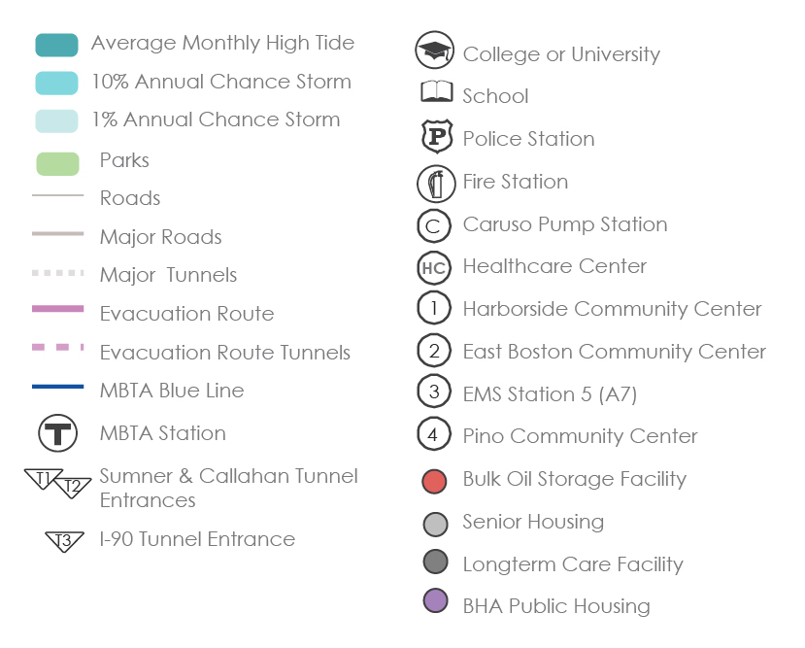
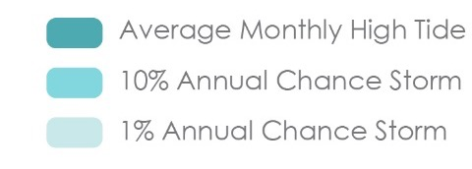
WHAT’S AT STAKE?
Community Assets and Flooding
9’’ sea level rise
2030s-2050s
East Boston
In the near term, exposure will be concentrated near the East Boston Greenway, Central Square, and the Sumner/Callahan Tunnel entrances.
Notes:
East Boston is surrounded on 3 sides by water, making access across the many tunnels especially important.
*Eight 1-90 and Route 1A tunnels, as well as the Wood Island, Orient Heighs, and Suffolks Downs T stops are at risk in a 1% annual chance flood.
*This level of flooding would also place important community assets at risk including the Boston Police District A-7 on Paris Street and the East Boston Social Center.
*The Engine 9 & Ladder 2 firehouse on Summer St is exposed to even more frequent 10% annual chance flooding along with the Mario Umana Academy. Massport has identified back up fuel for emergencies given fuel storage facilities are also at risk.

Slide 5
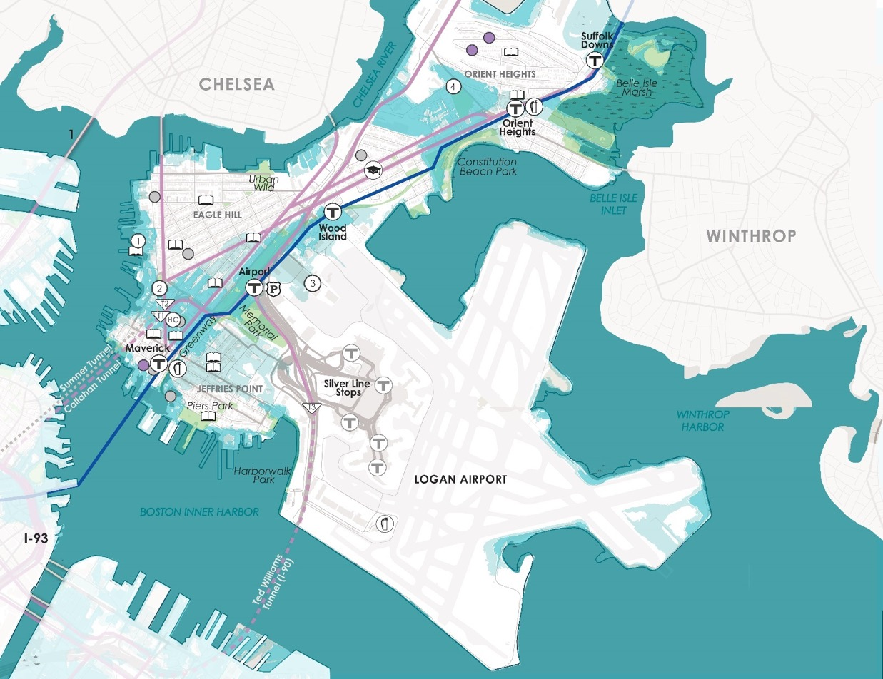
WHAT’S AT STAKE?
Community Assets and Flooding
21’’ sea level rise
2050s-2070s
East Boston
In the middle of the century, 10% annual chance flooding events mean the Airport T Stop is exposed. With a 1% annual chance event Engine 56 & Ladder 21 Firehouse on Ashley Street Orient heights would be impacted along with healthcare facilities, schools, and community centers.
Notes:
In the middle of the century, 10% annual chance flooding events mean the Airport T Stop is exposed. With a 1% annual chance event Engine 56 & Ladder 21 Firehouse on Ashley Street Orient heights would be impacted along with healthcare facilities, schools, and community centers.

Slide 6
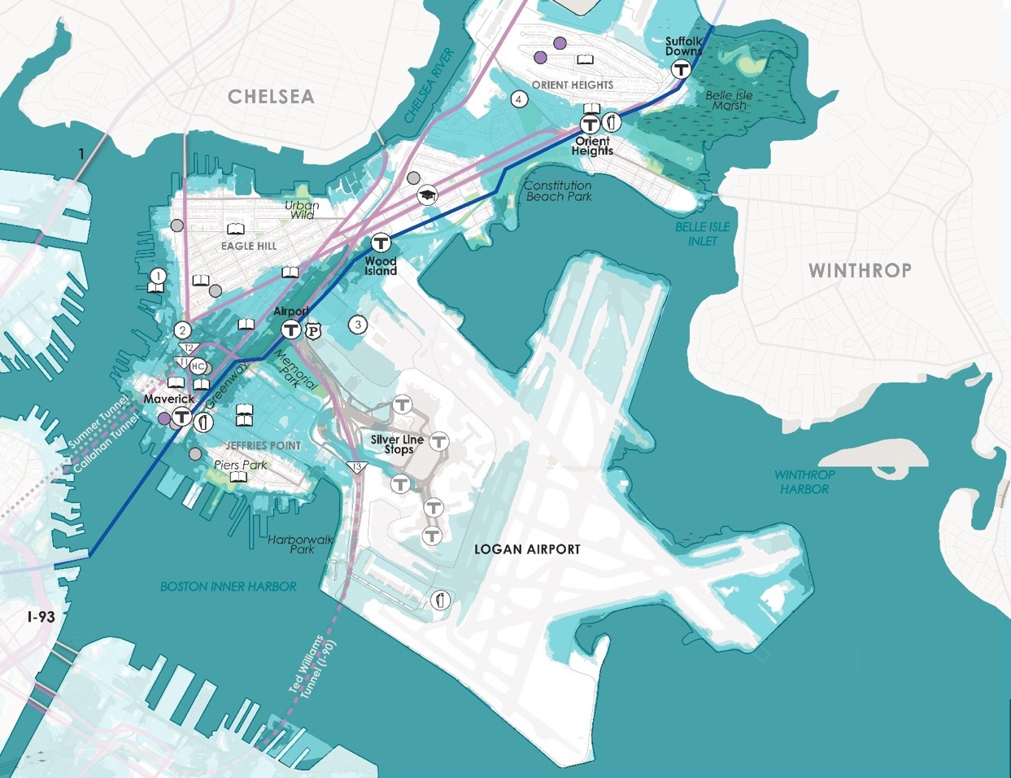
WHAT’S AT STAKE?
Community Assets and Flooding
36’’ sea level rise
2070s or Later
East Boston
By late century, 10% annual chance flooding events will impacts the Ted Williams Tunnel entrance, Airport Silver Line stops, multiple MassDOT stormwater pump stations and other community assets.

Slide 7
WHAT’S AT STAKE?
People and Buildings Impacted by 1% Annual Flood Events
19,070
PEOPLE
3,080 BUILDINGS
(Worth $25B)
7,020
PEOPLE
1,070 BUILDINGS
(Worth $5B)
2030+
2070+
Notes:
By the end of the century, East Boston could incur more than $1.7 billion in economic losses from flooding.

Slide 8
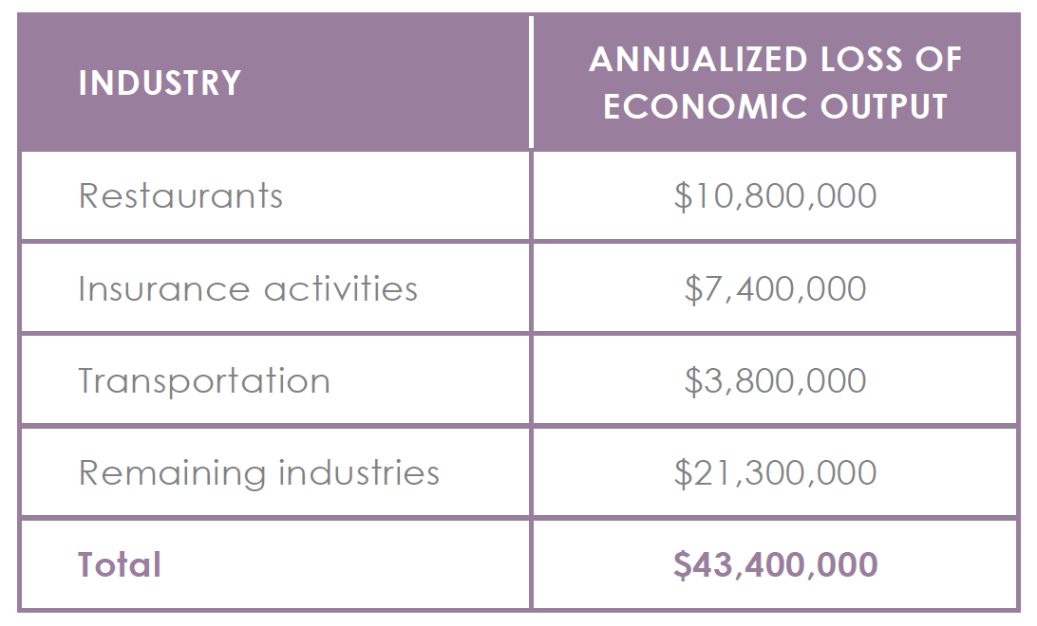
WHAT’S AT STAKE?
Economic Output and Jobs
$8M loss of economic output + 50 jobs per year towards the end of the century.

Slide 9
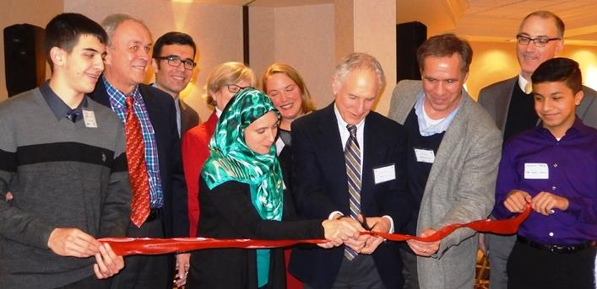
EAST BOSTON IN ACTION
Prepared and Connected Communities
PROPOSED STRATEGIES:
Engage Bostonians as partners
Co-create neighborhood plans
Provide training for jobs in resilience
Notes:
Condor Wild as an example of what’s possible - ensuring smart development
Helping out local biz re: responding insurance
You can get specific here for your neighborhood/sector. Can always switch out photos to match those examples.

Slide 10
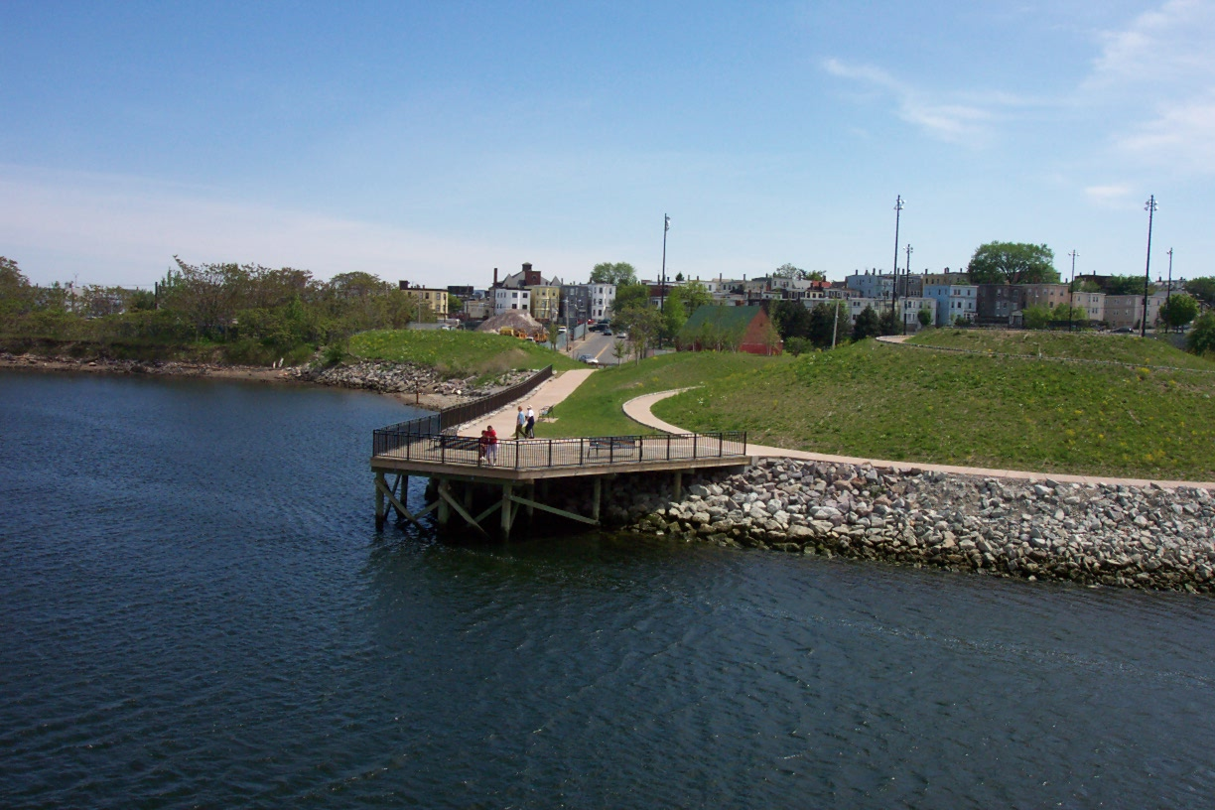
EAST BOSTON IN ACTION
Protected Shores
PROPOSED STRATEGIES:
Near term protection is needed at Jeffries and Central Squares to address flooding along the waterfront.
Add protections later to Porzio Park, Wood Island and Orient Height.
Protections at all four sites reduces flood risks for Logan Airport.
Notes:
Focus on the neignborhood examples to create relevance.
Hone in on the specific locations being considered/

Slide 11
EAST BOSTON IN ACTION
Resilient Infrastructure
PROPOSED STRATEGIES:
Develop coordinated risk response plans for extreme weather events.
Support MTBA’s assessment of flooding to the Blue Line.
Explore options for a neighborhood energy grid in Central Square.
Notes:
http://www.subchat.com/read.asp?Id=1175613

Slide 12
EAST BOSTON IN ACTION
Adaptive Buildings
PROPOSED STRATEGIES:
Update zoning and building codes and notify developers with projects in the pipeline to update plans.
Help building owners assess potential impacts and increase resilience.
Promote access to insurance.
Prepare municipal buildings to withstand change.
Notes:
http://www.subchat.com/read.asp?Id=1175613

