Slide 1
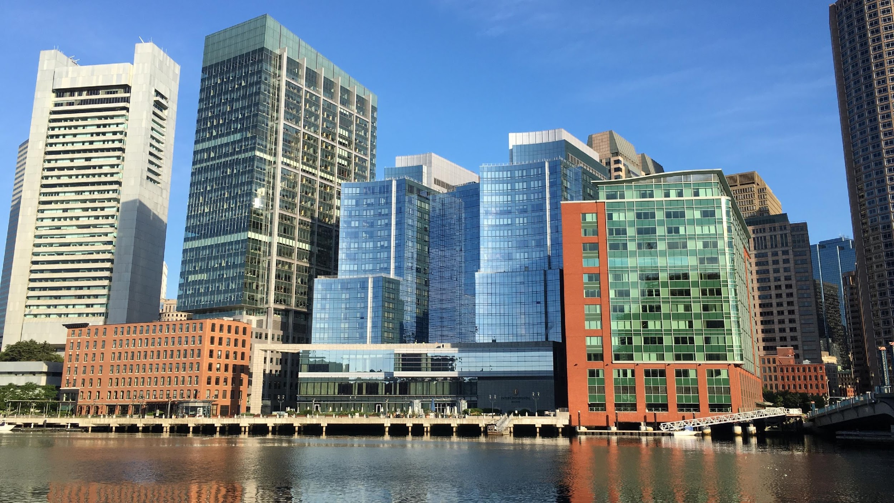
BIENVENIDO A
CLIMATE READY
BOSTON
Notes:
Thanks! Great working with the City & GRC.
Thanks to those who attended the first design workshop but also who took the time to speak with me/send ideas post design workshop
*Some partners already giving climate talks & looking for the latest data/best way to present it. For others, presenting CRB findings not enough. Ready to engage with the city re: sector or neighborhood specific challenges and approaches.
Today – share basic climate leaders peer based outreach presentation & approach in am. In pm – enter a dialogue with the City re: ways to collaborate with CBOs re: resilience initiatives. Presentation & materials STILL IN DRAFT FORM – will be finalized post workshop.
This am – City re: update on CRB, how input from design session is being used, plans for Climate Leaders program moving forward.
Walk through materials
Hands on – time to adapt/revise
LUNCH
PM – Here from City re: efforts underway in E Boston. Walk through E Boston supplemental materials. Discuss collaboration opportunities. End at 3.
DIALOGUE DOC – presentation points, detailed messaging + tips – things you don’t need to lead with but may want in your back pocket.

Slide 2
THE CLIMATE READY CHALLENGE
OBJETIVOS DEL PROGRAMA LÍDERES DEL CLIMA DE CRB
Mejorar el conocimiento de los efectos
Involucrar a los miembros de la comunidad en la promoción de las
estrategias de capacidad de resitencia
LOS EFECTOS YA SON UNA REALIDAD. TIEMPO PARA PREPARARSE.
Notes:
GOAL – increase awareness & understanding. Involve community members, business etc. in developing response strategies. INPUT critical re: detailed understanding of how climate risks are playing out/impacting people’s lives + develop sensitive solutions.
Overall approach:
Concise & accessible
relevance of data versus science lesson
Position issue in the near term re: impacts people noticed & solutions underway to build on
Balance seriousness of what the data says with a can do attitude
People and equity – this is about Boston
START: Quick mention that in the last three years, worst heat wave/snow storms – places it in the present
Shift to purpose for the dialogue – understanding risks, relevance, solutions and how to help forward.

Slide 3
¿POR QUÉ ESTAMOS AQUÍ?
A QUÉ NOS ENFRENTAMOS
VISIÓN DE CLIMATE
READY
BOSTON
QUÉ PUEDE HACERSE
Notes:
Outline plan for the dialogue.
Sequence – lead with the vision of what a CRB would be like
Then impacts re: the imperative followed by resilience strategies. Putting impacts into the middle of the vision and specific action steps makes climate impacts less overwhelming/fatalistic.
Some stakeholders you engage with might be interested in the detailed data however most want to know what does this mean for me and what can I do. Therefore, your job is not to perfectly convey all the details of the science, economics etc. but create a sense of relevance and possibility.

Slide 4
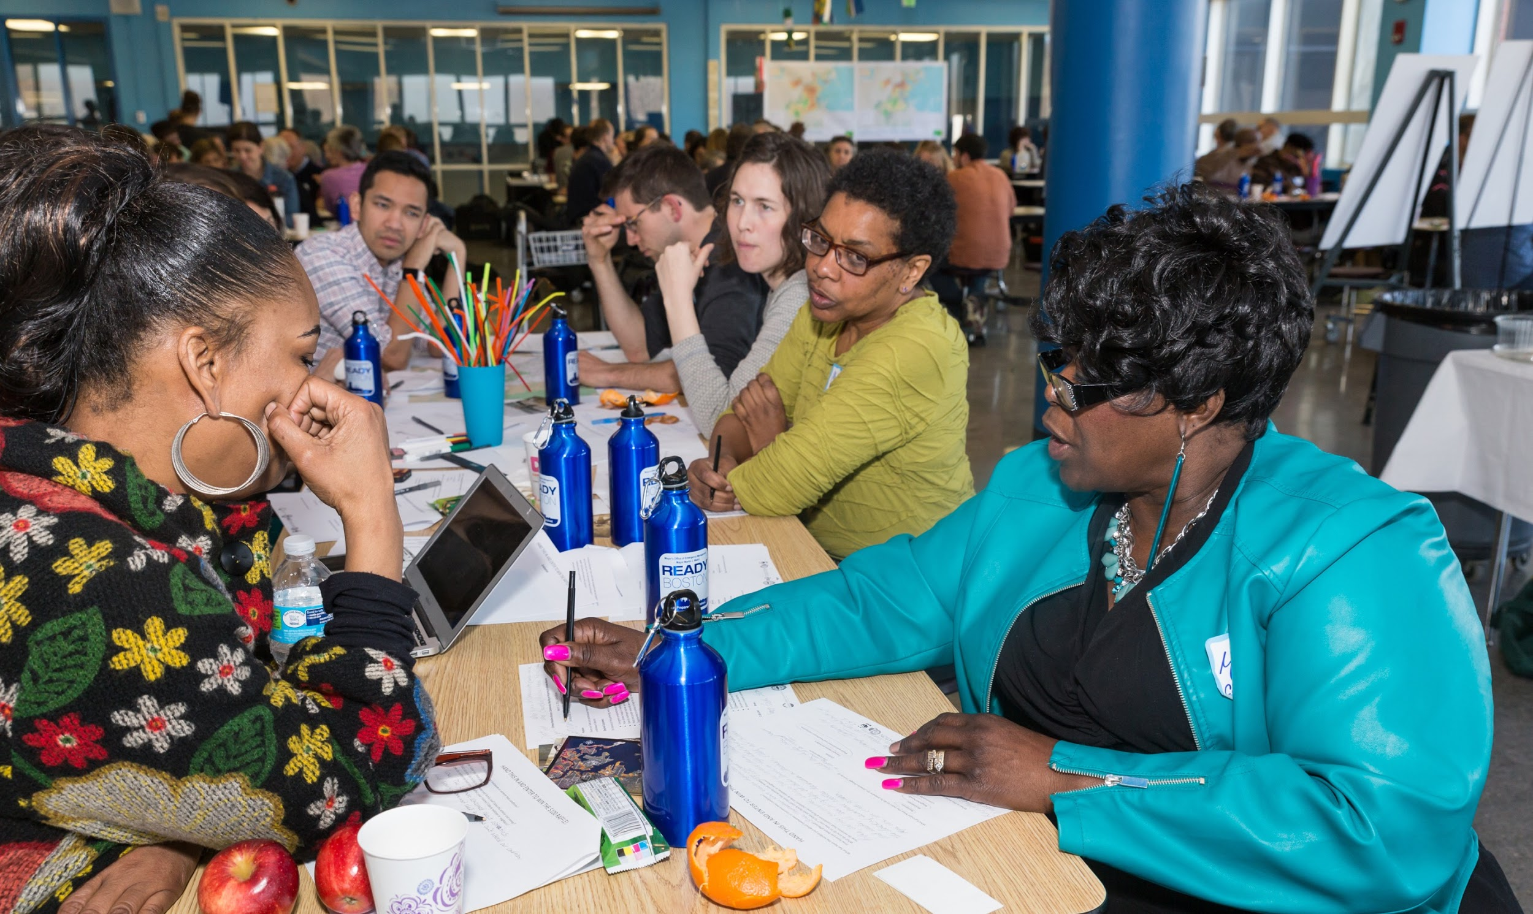
TRABAJANDO UNIDOS
BOSTON RESEARCH
ADVISORY GROUP
Climate Ready Boston tiene el objetivo de preparer a la ciudad para los efectos del cambio climático.
https://www.boston.gov/environment-and-energy/climate-ready-boston
Notes:
Details on what the CRB project is all about. The people you are engaging may not need much detail however others might need the context, information on the partners & how the report was done. MAIN POINT – City’s leadership critical however many players coming together to ready Boston.

Slide 5
UN BOSTON PREPARADO PARA EL CAMBIO CLIMÁTICO
WHAT WE
STAND TO
GAIN
La restauración de Muddy River Flats brinda protección contra inundaciones al mismo tiempo amplía el acceso a espacios abiertos y a la belleza.
Promover urbanizaciones inteligentes y edificaciones adaptables, mejorando la calidad de vida y posicionando a Boston para el futuro
CLIMATE READY BOSTON
Notes:
https://media.defense.gov/2015/Dec/23/2001328586/-1/-1/0/151223-A-KF207-002.JPG
The VISION:
Giving a sense of the benefits/what’s possible with a CRB. Orienting to local examples (i.e. Muddy Flats) which is about quality of life (improved access to open space, beauty and flood protection at the same time).
CAN REPLACE WITH A NEIGHBORHOOD OR SECTOR SPECIFIC EXAMPLE.

Slide 6
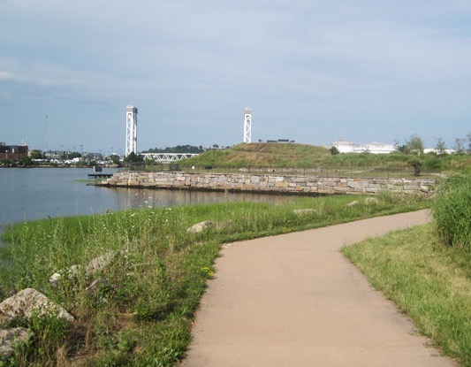
UN BOSTON PREPARADO PARA EL CAMBIO CLIMÁTICO
El Condor Urban Wild Park , que una vez fuera un emplazamiento industrial, ahora ofrece acceso a la costa y protección contra las inundaciones
Mejorando los vecindarios, espacios abiertos y costas.
CLIMATE READY BOSTON
Notes:
Improving areas of the city is a core benefit (avoid “co-benefits) and addressing equity.
E Boston example re: Condor Urban Wild restoration (cleaning up toxic, unused area + access to shore + flood protection/protected shoreline)

Slide 7
UN BOSTON PREPARADO PARA EL CAMBIO CLIMÁTICO
Zonificación para el cambio climático
Paneles solares y micro-redes del distrito
Barrera potencial para el puerto
Iniciativa educativa y de compromiso
Protección contra inundaciones a escala de distrito
La adaptación como herramienta para el desarrollo económico
Sistemas mecánicos elevados
Programa de preparación para pequeños negocios
Barrera temporal parinundacionesa las
Diseño resistente para los edificios
Primer piso elevado
Parque costero protector e inundable
Dosel urbano cuidado y ampliado
Sistema de biofiltración de infraestructura verde
Transito energía y demás sistemas esenciales fiables. Edificios seguros y cómodos.
CLIMATE READY BOSTON
Notes:
Quality of life & equity key benefits but CRB also means – strong, reliable infrastructure + buildings.

Slide 8
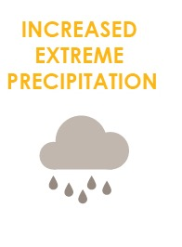
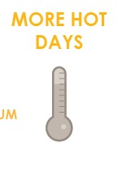
LOS EFECTOS YA SE ESTÁN PRESENTANDO
Mayores niveles de elevación del nivel del mar
Aumento de las precipitaciones extremas
Más días cálidos
Grupo Asesor de Investigaciones de Boston
Notes:
Once you have painted a vision of a desirable CRB future, shift to the imperative – not just good to do but must do given what is being faced.
Good to emphasize “SCIENTISTS AGREE” as we know this can be a point where we lose people.
Notes include re: reduction of cold days but a bit harder to get across why fewer cold days are a bad thing to most people.

Slide 9
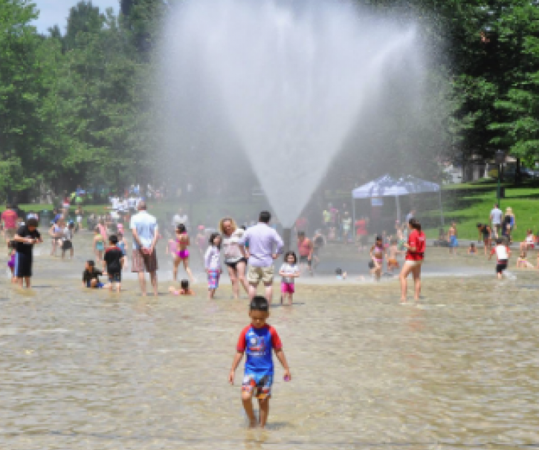
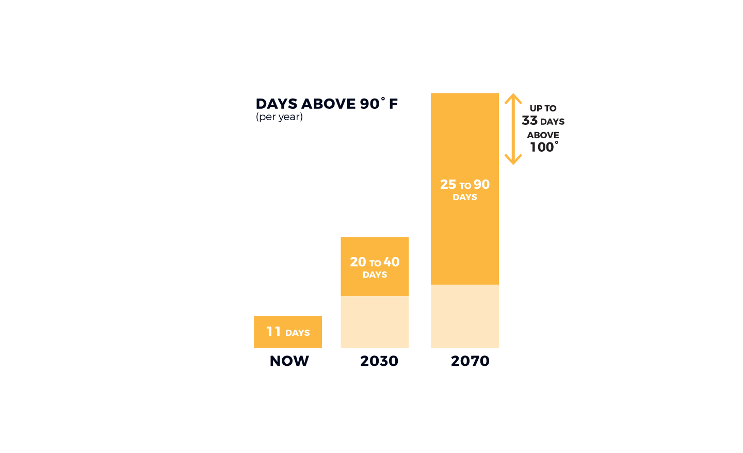
DÍAS MÁS CÁLIDOS
Los veranos de Boston podrían ser tan cálidos como los de Washington, D.C. en 5 años, y como los de Birmingham, Alabama en 80.
DÍAS DE MÁS DE 90 ° F
(al año)
HASTA 33 DÍAS DE MÁS DE 100°
25 A 90 DÍAS
20 A 40
DÍAS
11 DÍAS
AHORA
Notes:
Heat – looking again for the relevant examples I.e. talking about how many days above 90 now versus what’s in store for the future. Personalize it.
CAN ALWAYS SWAP OUT PHOTOS – BUT MAKE SURE YOU HAVE PEOPLE IN THEM – AVOID scary images.

Slide 10
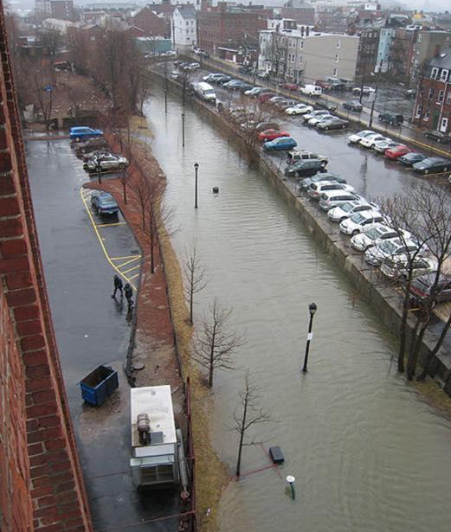
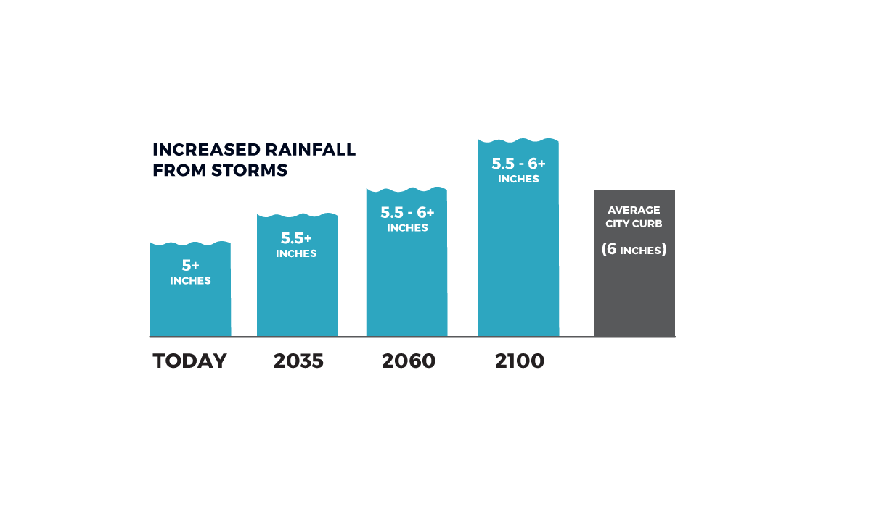
AUMENTO EXTREMO DE LA PRECIPITACIÓN
Para 2060, los fenómenos de lluvias fuertes podrían ocasionar que caigan más de 6 pulgadas en 24 horas, lo que es la altura promedio de una acera de la ciudad, y un 20% más de la que recibimos ahora.
AUMENTO DE LLUVIA PROVENIENTE DE TORMENTAS
PULGADAS
PROMEDIO DEL SARDINEL DE LA CIUDAD
PULGADAS
PULGADAS
PULGADAS
HOY
Notes:
Providing comparisons that people can relate to – as high as the average city sidewalk/ 20% more than what we are used to.

Slide 11
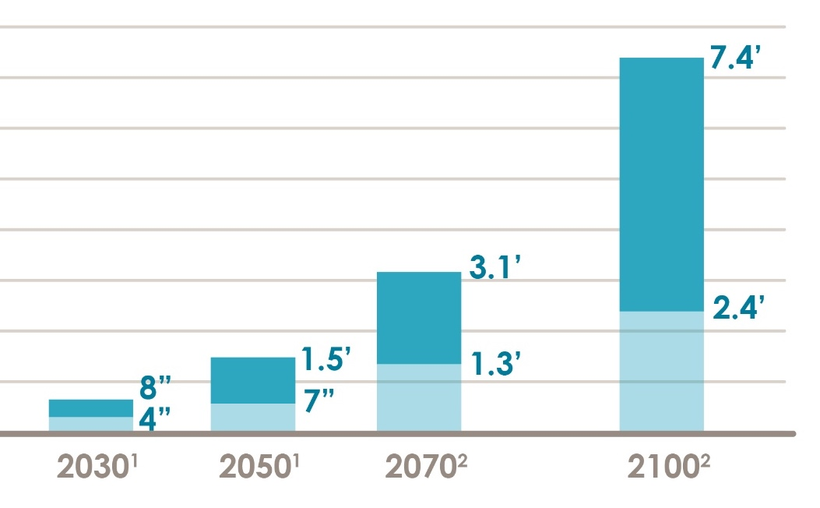
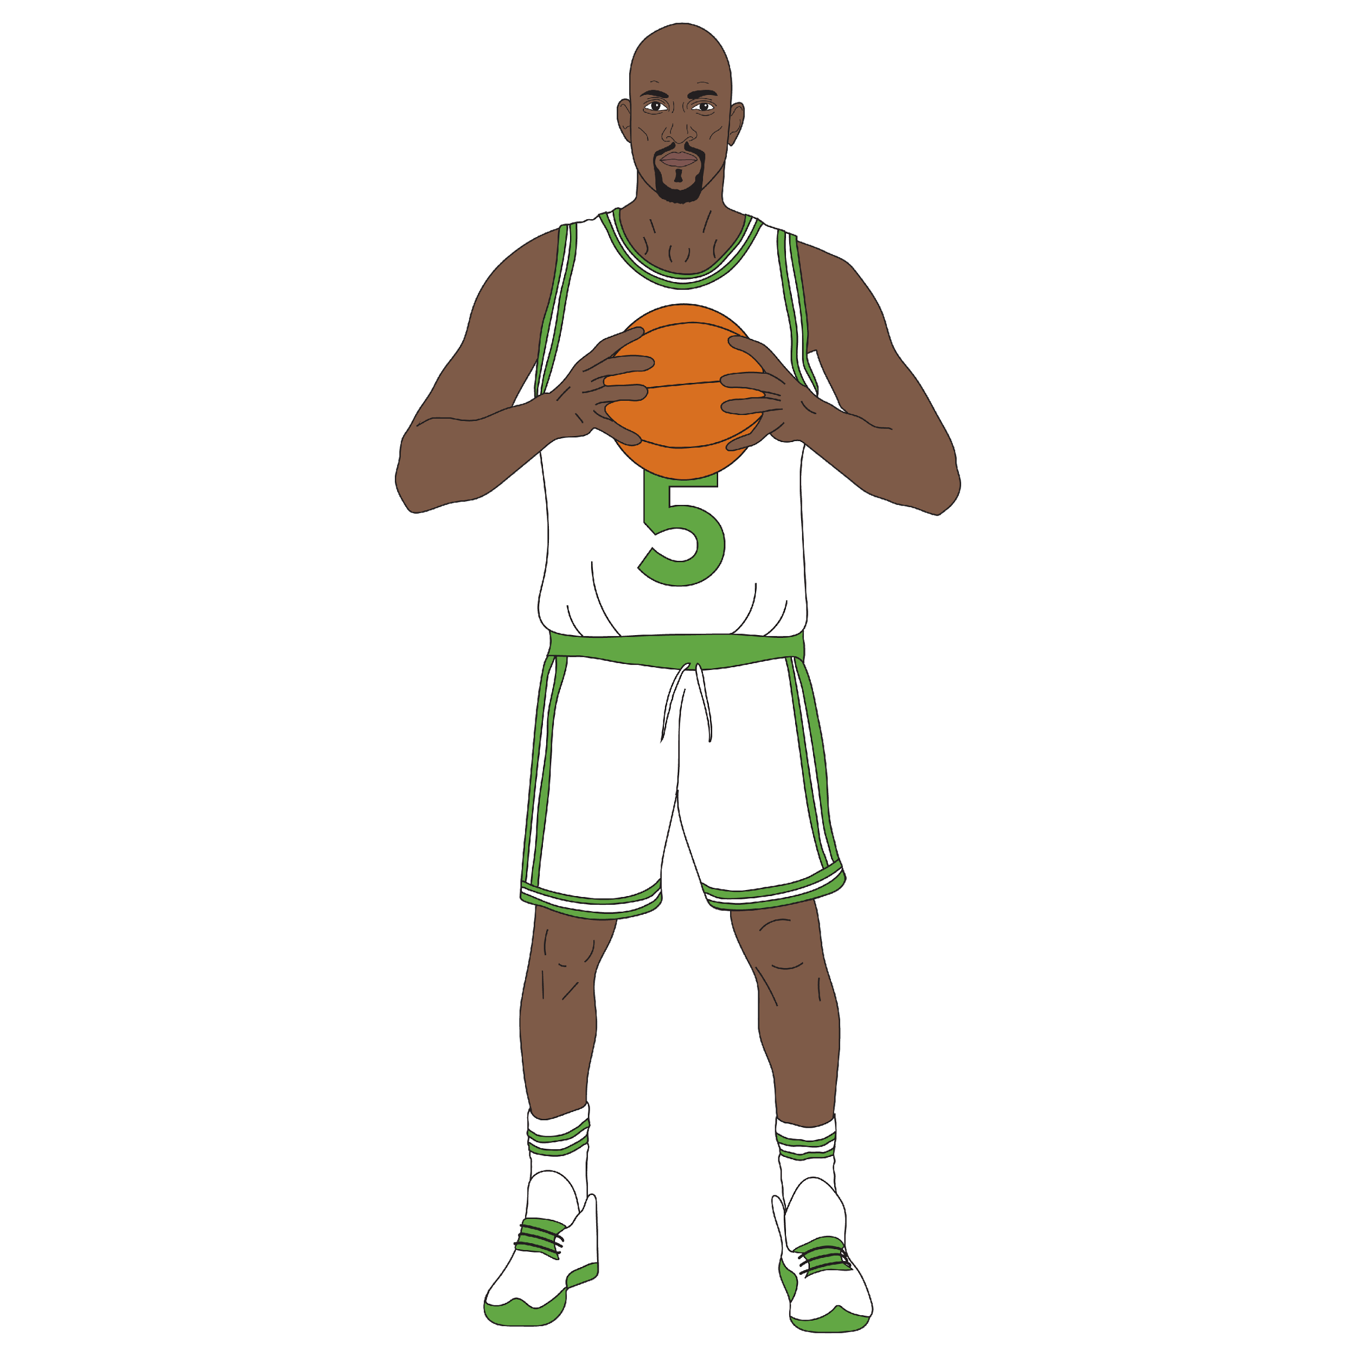
MAYOR ELEVACIÓN DEL NIVEL DEL MAR
De no reducirsen las emisiones, es probable que durante la segunda mitad del siglo, el nivel del mar se eleve por lo menos 3 pies.
PROYECCIONES RELATIVAS DE LA ELEVACIÓN DEL NIVEL DEL MAR DE BOSTON
6.11’
KEVIN GARNETT
Notes:
Don’t worry about explaining all the scenarios, possible flooding ranges & potential timelines. Easy to get lost in it and again, most don’t need to know.
Do need to know – SLR happening already + will make flooding worse as time goes on which means preparing now.
CRB uses inches of SLR in maps – important for technical but showing where flooding would come on your body provides an easy to understand reference. i.e. I’m only 5’3” so 3ft of flooding would be higher than my waist.

Slide 12
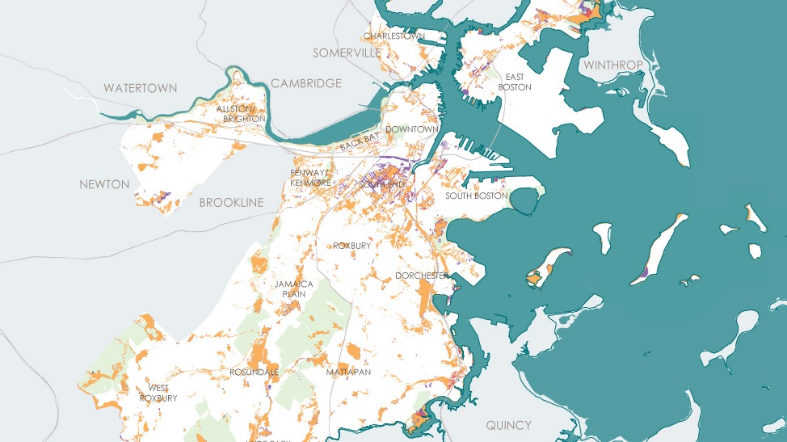
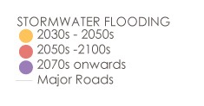
INUNDACIONES DE AGUAS PLUVIALES
INUNDACIONES DE AGUA PLUVIAL
2030 a 2050
2050 a 2100
De 2070 en Adelante
Carreteras principales
Notes:
ALREADY AN ISSUE.
Increase prec + SLR make worse
Like heat, impacts are city wide as all parts of the city have some locations at risk from increased exposure
Terminology for flooding events is confusing. Don’t worry about it. All you need to know is:
High probability flooding events (10% annual chance)
Low probability (1%)
Rare but major (0.1%)

Slide 13
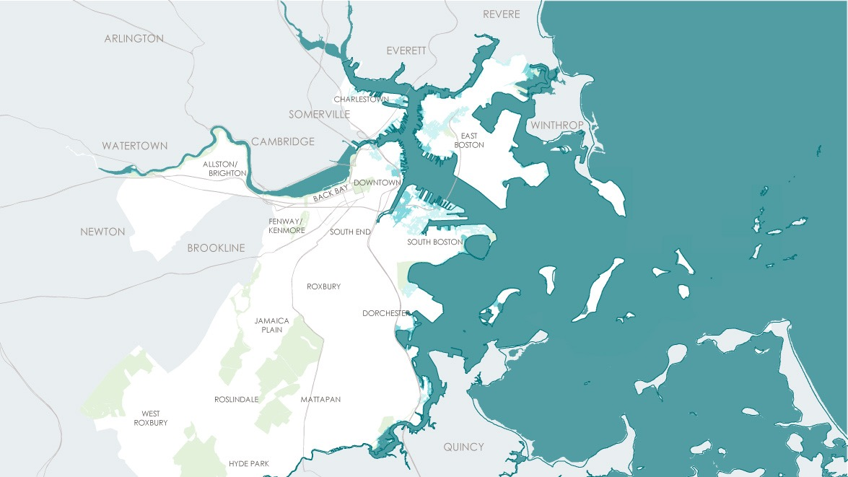
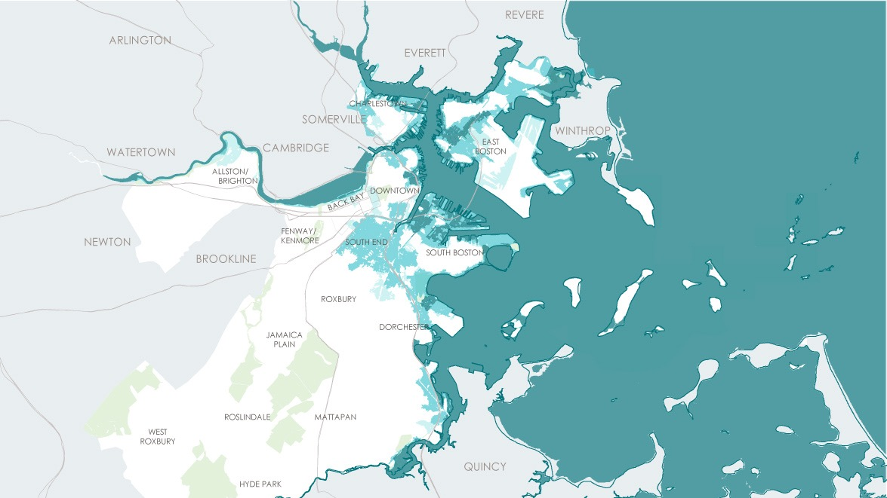
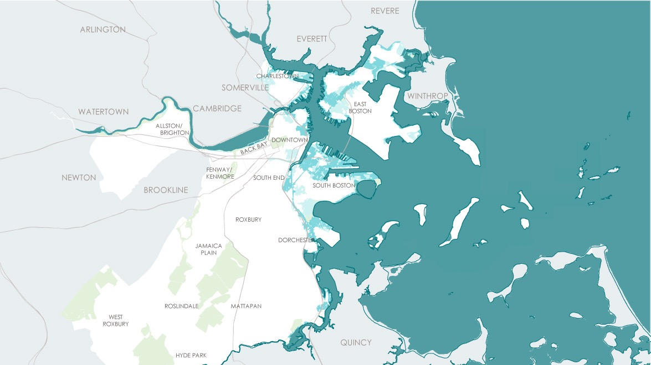
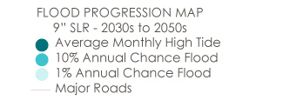
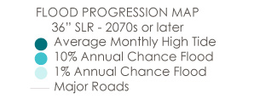
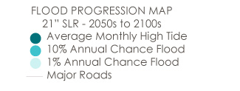
INUNDACIONES A LO LARGO DE LA COSTA Y RIOS
36” SLR – en 2070 o posteriormente
9” SLR – 2030s to 2050s
21” SLR – 2050s to 2100s
MAPA DE PROGRESIÓN DE LAS INUNDACIONES
36” SLF – 2070 o posteriormente
Promedio mensual de marea alta
10% de probabilidad anual de inundación
1% de probabilidad anual de inundación
Carreteras principales
Notes:
SLR – Don’t get bogged down by inches or years. NEAR TERM – MID Term (or mid-century) – later in the century.
Near term – South Boston, East Boston, Charlestown and Downtown
Mid Century – most waterfront neighborhoods + into Dorchester
Late Century – vast parts of the city + South End & along Charles River
Points to need to act now because range not locked in – dependent on carbon reductions. Act now while there is more flexibility and costs can be managed.

Slide 14
¿QUÉ ESTÁ EN JUEGO?
Las personas y edificios expuestas a un riesgo de inundación del 1%
12,000 EDIFICIOS
(Valorados en $85B)
18,000
PERSONAS
85,000
PERSONAS
2,000 EDIFICIONS
(Valorados en $20B)
2030+
2070+
Notes:
Lots of details re: impacts to people, building and value, and economy.
Can’t cover it all therefore 1% storms chosen as they are the mid scenario
Lead with this but customize per who you are engaging with - i.e. pull out social vulnerabilities & economics.

Slide 15
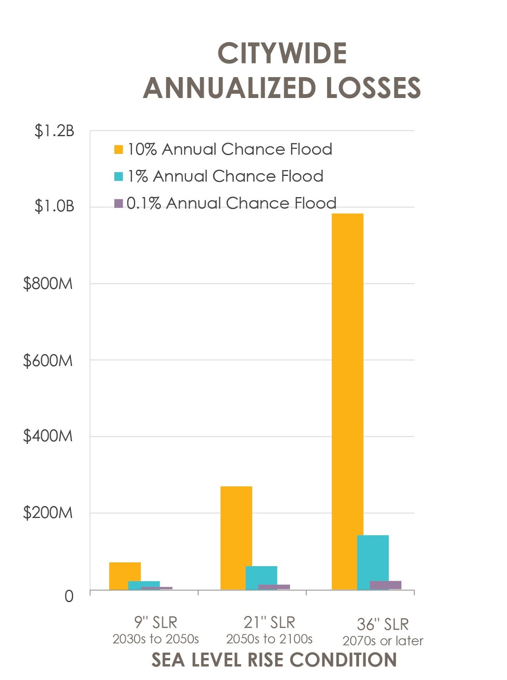
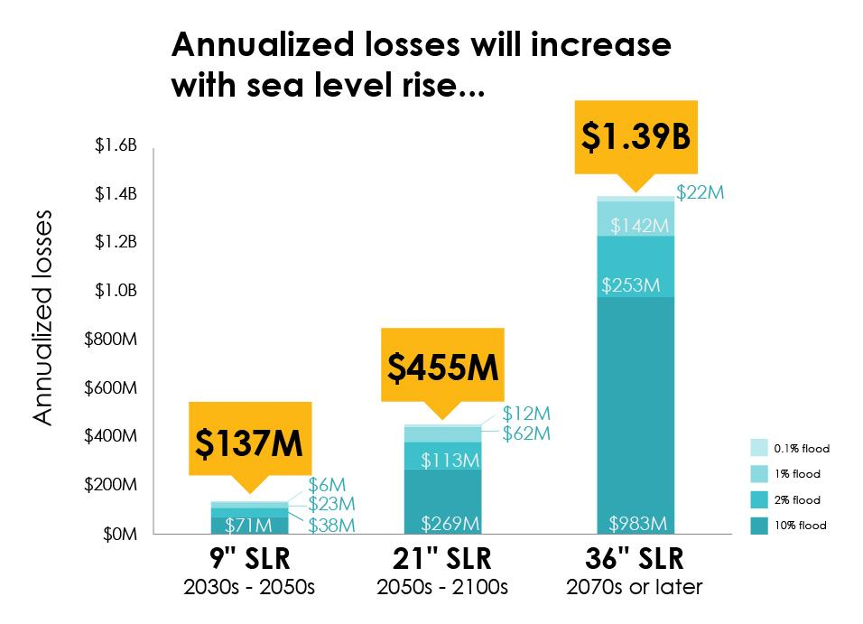
ECONOMÍA
PÉRDIDAS ANUALIZADAS DE TODA LA CIUDAD
Las pérdidas anualizadas aumentarán con el aumento del nivel del mar
Probabilidad de inundación anual del 10%
Probabilidad de inundación anual del 1%
Probabilidad de inundación anual del 0.1%
$1.39B
Pérdidas anualizadas
$22M
$142M
$253M
$455B
$137M
$12M
$62M
$113M
$6M
$23M
$38M
$71M
$269M
$983M
2030 a 2050
2050 a 2100
2070 o posteriormente
La mayoría de los costos provienen de los daños estructurales y la pérdida de contenido.
2030 a 2050
2050 a 2100
2070 o posteriormente
CONDICIÓN DE ELEVACIÓN DEL NIVEL DEL MAR
Notes:
Lots of details re: impacts to people, building and value, and economy.
Can’t cover it all therefore 1% storms chosen as they are the mid scenario
Lead with this but customize per who you are engaging with - i.e. pull out social vulnerabilities & economics.

Slide 16
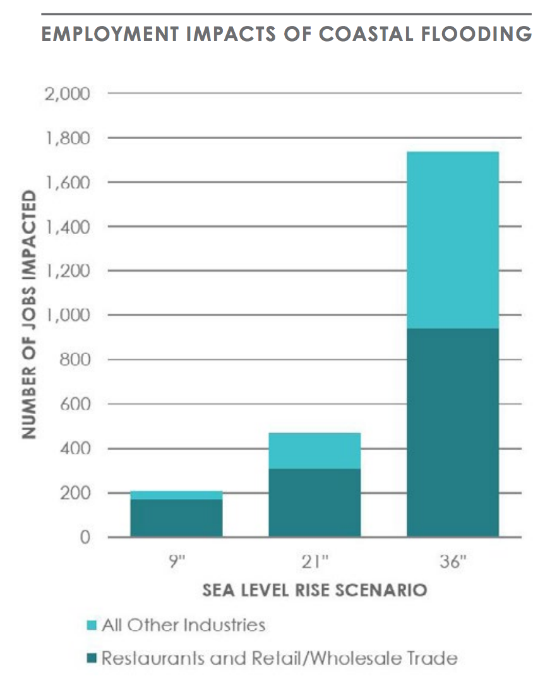
ECONOMÍA
EFECTOS DE LAS INUNDACIONES COSTERAS EN EL EMPLEO
NÚMERO DE EMPLEOS AFECTADOS
La mayoría de los restaurantes, la finca raíz, el comercio minorista y mayorista, y las industrias del transporte están en riesgo, así como los asalariados que perciben salarios moderados o bajos están en riesgo de interrupción de las actividades comerciales.
ESCENARIO DE ELEVACIÓN DEL NIVEL DEL MAR
Todas las demás industrias
Restaurantes y comercio mayorista y minorista
Notes:
Lots of details re: impacts to people, building and value, and economy.
Can’t cover it all therefore 1% storms chosen as they are the mid scenario
Lead with this but customize per who you are engaging with - i.e. pull out social vulnerabilities & economics.

Slide 17
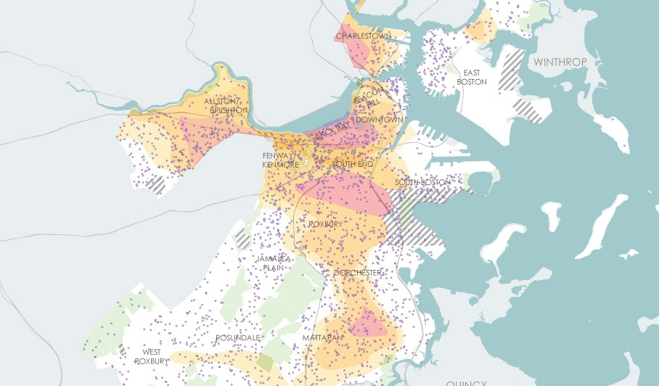
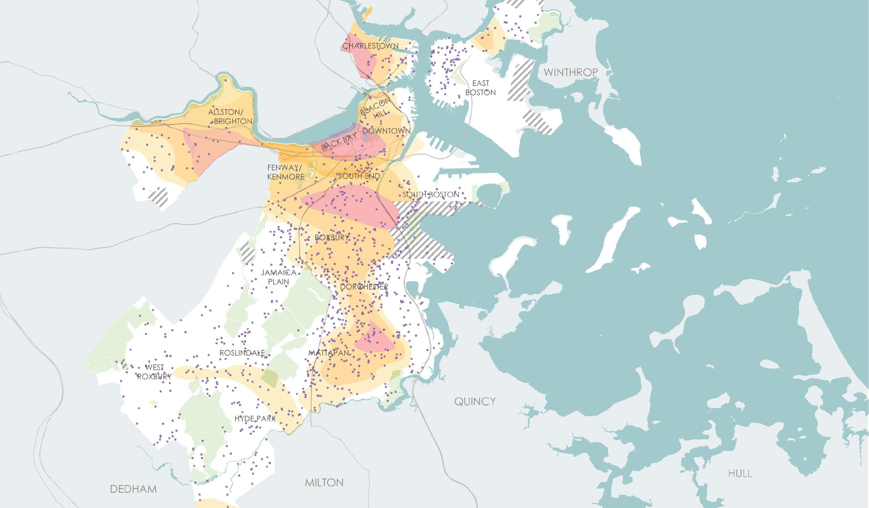
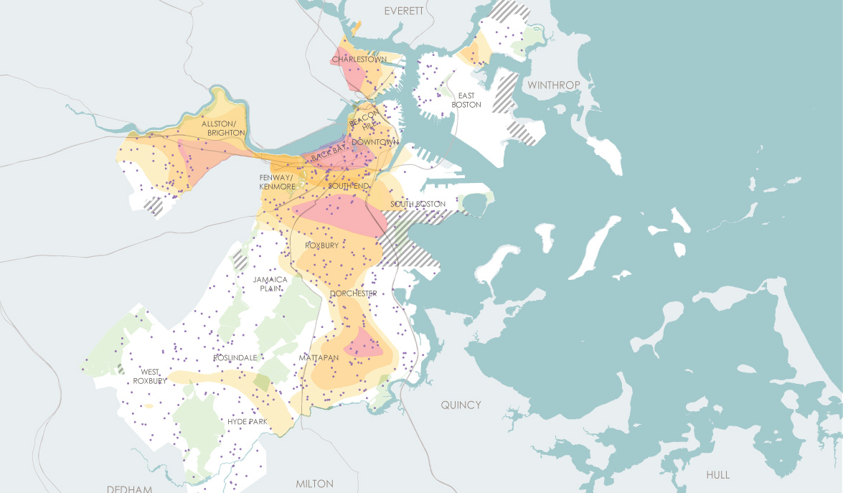
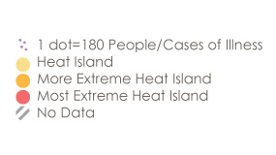
EXPOSICIÓN A LA ISLA DE CALOR
Children and Heat Island Exposure
Medical Illness and Heat Island Exposure
Los adultos mayores y la exposición a la isla de calor
1 punto – 180 personas/casos de enfermedad
Isla de calor
Isla de calor más extrema
Isla de calor sumamente extrema
Sin datos

Slide 18
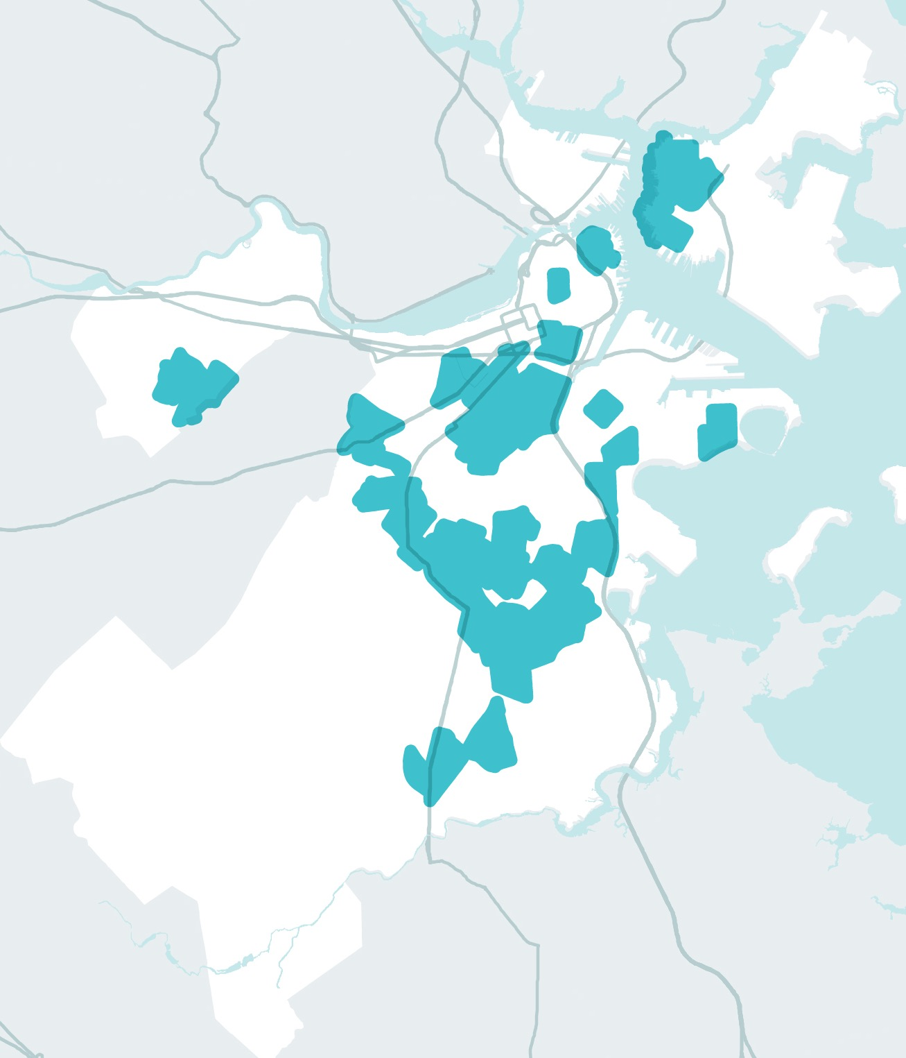
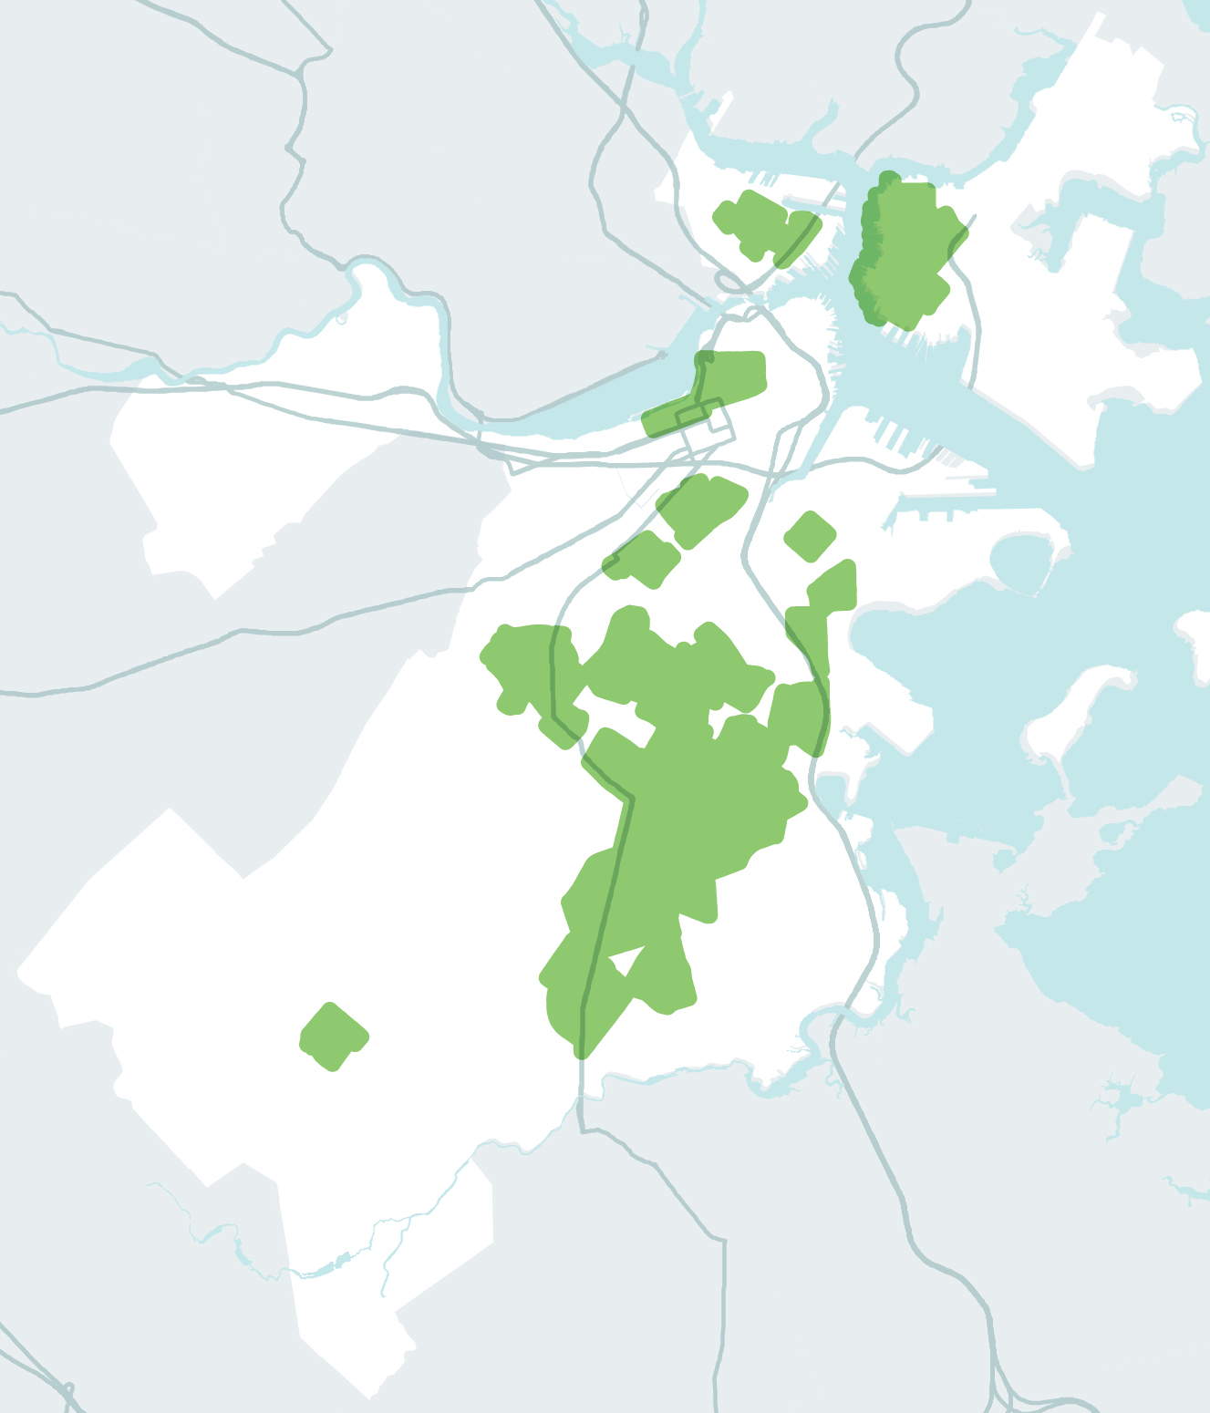
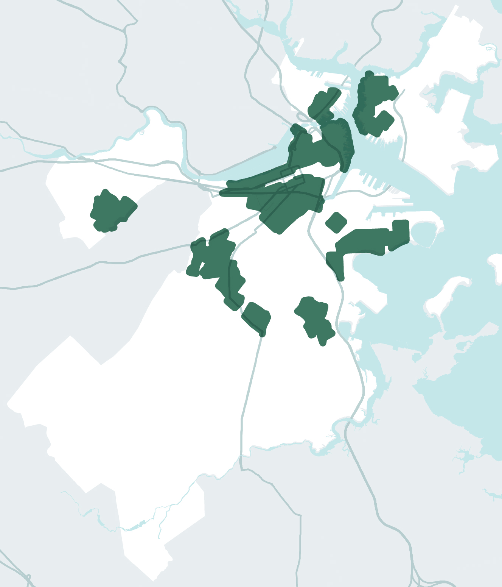
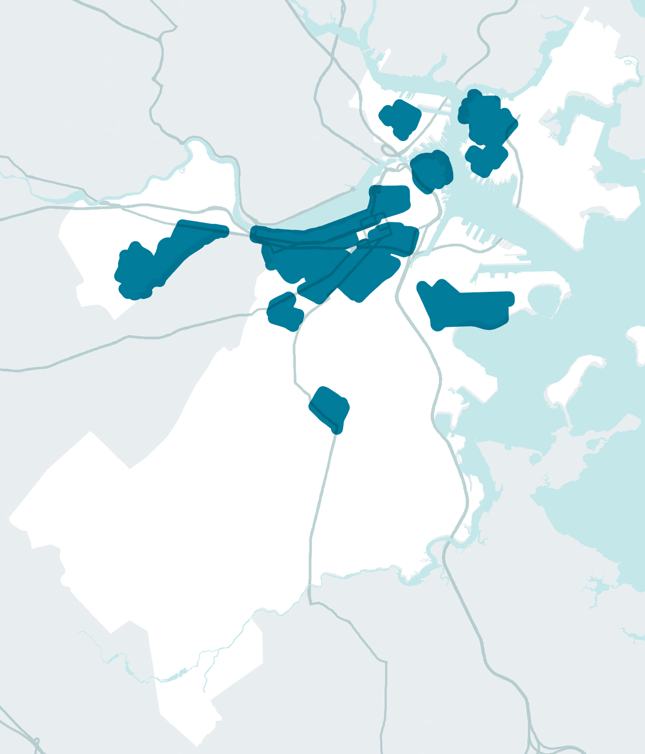
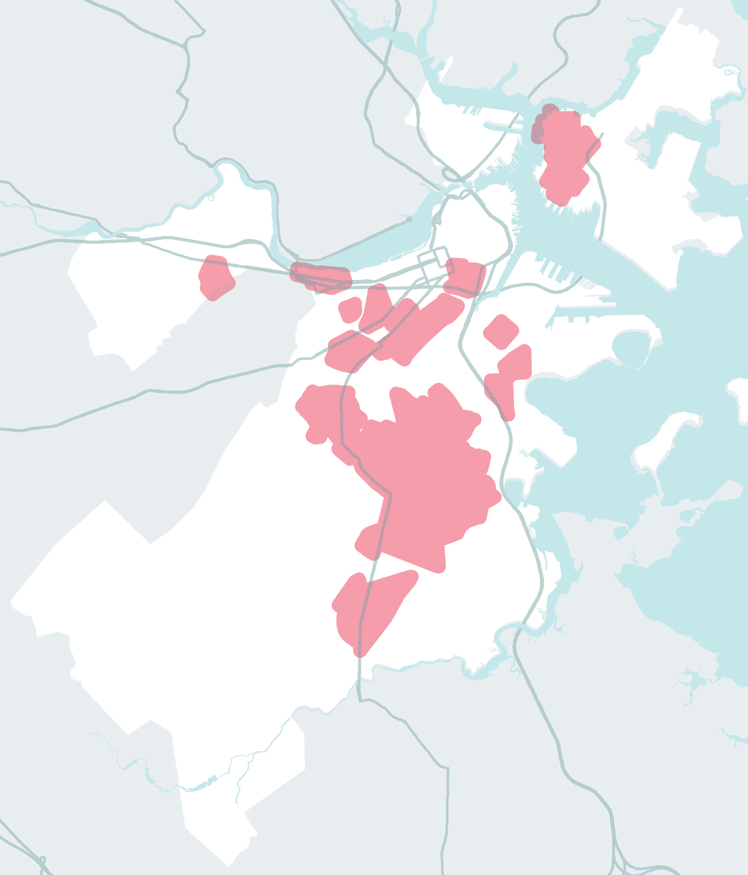
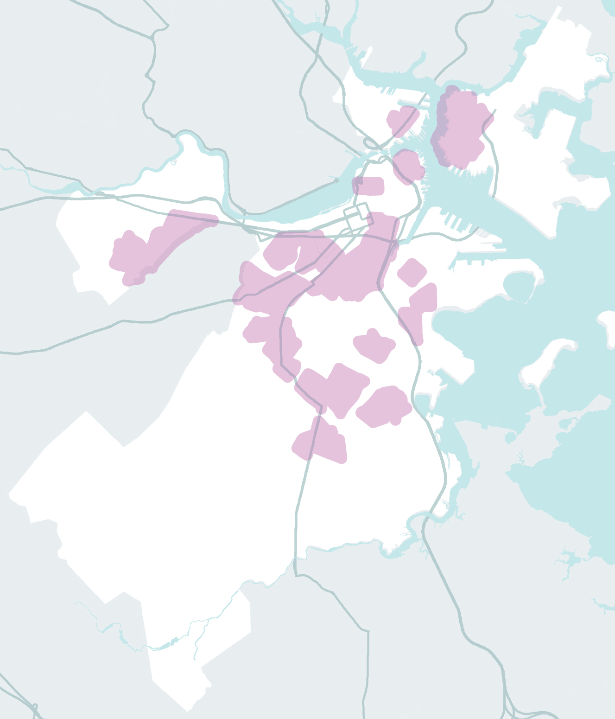
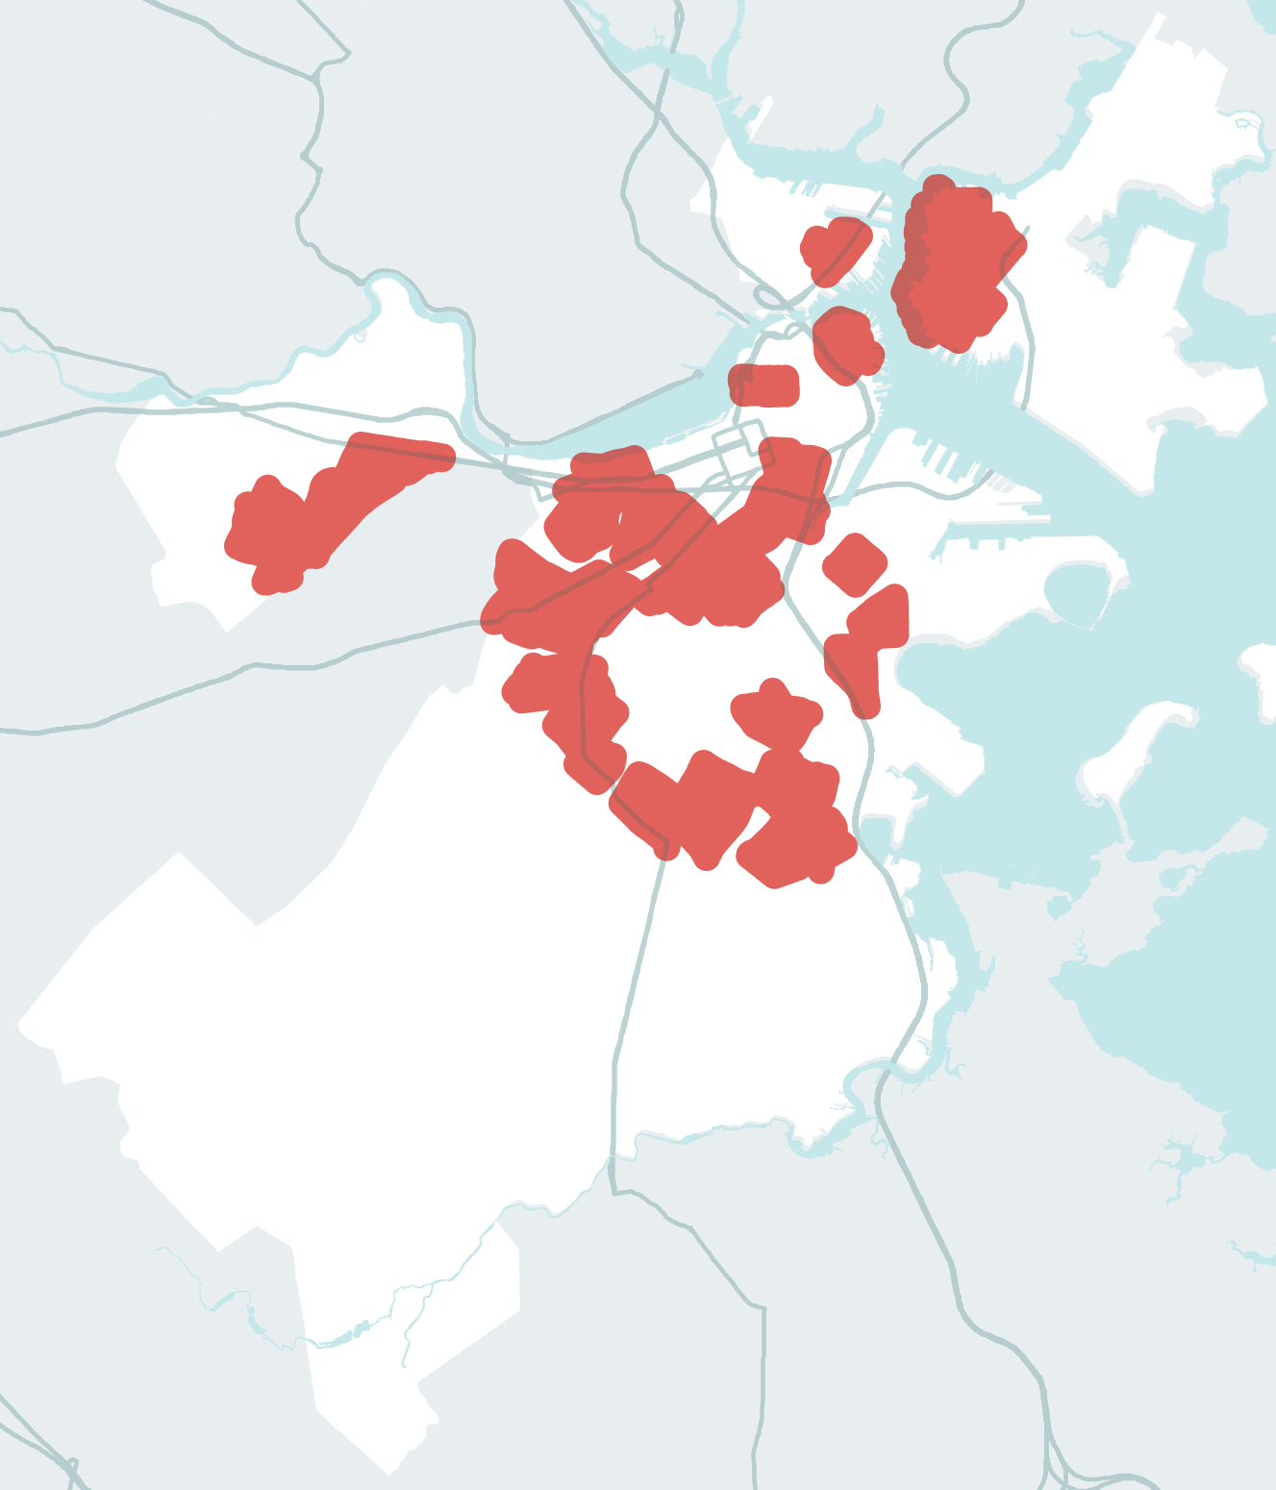
CONCENTRACIÓN DE POBLACIÓN SOCIALMENTE VULNERABLE
CONCENTRATIONS OF SOCIALLY VULNERABLE POPULATIONS
CONCENTRATIONS OF SOCIALLY VULNERABLE POPULATIONS
CONCENTRATIONS OF SOCIALLY VULNERABLE POPULATIONS
CONCENTRATIONS OF SOCIALLY VULNERABLE POPULATIONS
CONCENTRATIONS OF SOCIALLY VULNERABLE POPULATIONS
CONCENTRATIONS OF SOCIALLY VULNERABLE POPULATIONS
“LAS PERSONAS NO SE VEN IGUALMENTE AFECTADAS”.
63,187
236,938
70,701
104,659
327,284
176,059
239,246
PEOPLE WITH LIMITED
ENGLISH PROFICIENCY
CASOS DE ENFERMEDADES MÉDICAS
PEOPLE WITH DISABILITIES
OLDER ADULTS
CHILDREN
PEOPLE OF COLOR
PEOPLE WITH LOW-TO-NO INCOME
Notes:
Important to call out that social vulnerabilities and inequity affect how people will be impacted by climate disruptions. Quite a lot in the CRB report on this you can pull from.
Topline – age, health, physical disabilities, income, race play a role and must be recognized as a foundational factor in how Boston responds.
Depending on who you are engaging, it may make sense to focus more on this information. More in the neighborhood slides but important to note the extent to which this was a leading part of CRB.

Slide 19
ENFOQUE EN LOS VECINDARIOS
Notes:
Starting to shift to what’s possible. Point out that CRB takes risks and potential responses down to the neighborhood level. Part of what makes the effort unique as most communities have not brought climate impacts projections down to this level of detail.
Have neighborhood slides in development. Could choose to start with this presentation or lead right into neighborhood specifics depending on audience. Even within the neighborhoods slides, call outs to how impacts care in one area versus another.

Slide 20
Estar a la altura del DESAFIO
Consenso de Proyección Climática
Costas
protegidas
Infraestructura
resistente
Edificios
adaptados
Comunidades preparadas y conectadas
Notes:
Don’t need to detail out there are 11 resilience strategies as they fall into 5 key action areas which is easier to wrap your head around.
Climate Projection – for all Boston versus other solutions get specific in the focus areas.

Slide 21
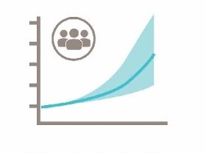
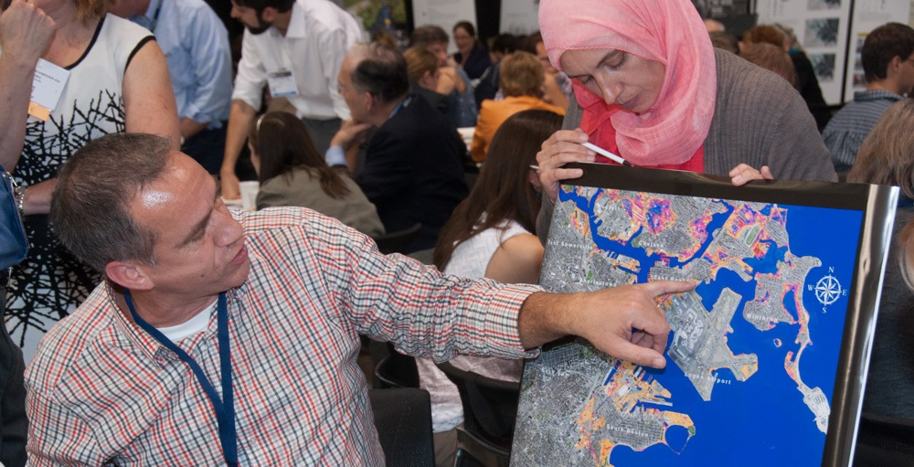
PROYECCIONES CLIMÁTICAS ACTUALIZADAS
ESTRATEGIAS PROPUESTAS:
Actualizar los datos cada 5 años y convertirlos en herramientas
Notes:
Data evolving rapidly. Need to continue to build on the scientific consensus by updating projections every 5 years.
Best available data to support smart decision making.

Slide 22
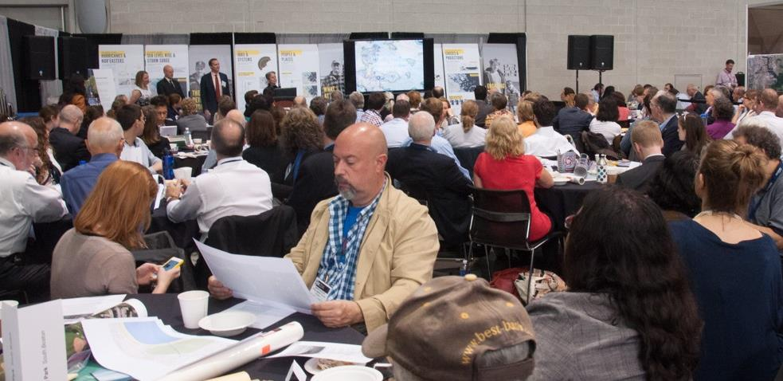
COMUNIDADES PREPARADAS Y CONECTADAS
ESTRATEGIAS PROPUESTAS:
Vincular a los bostonianos como socios
Crear conjuntamente planes para los vecindarios
Proporcionar capacitación en trabajos de resiliencia
Notes:
*People need to understand risks to respond
*Impacts are better understood with local knowledge
*Community sensitive solutions
*co-creating plans for the focus areas

Slide 23
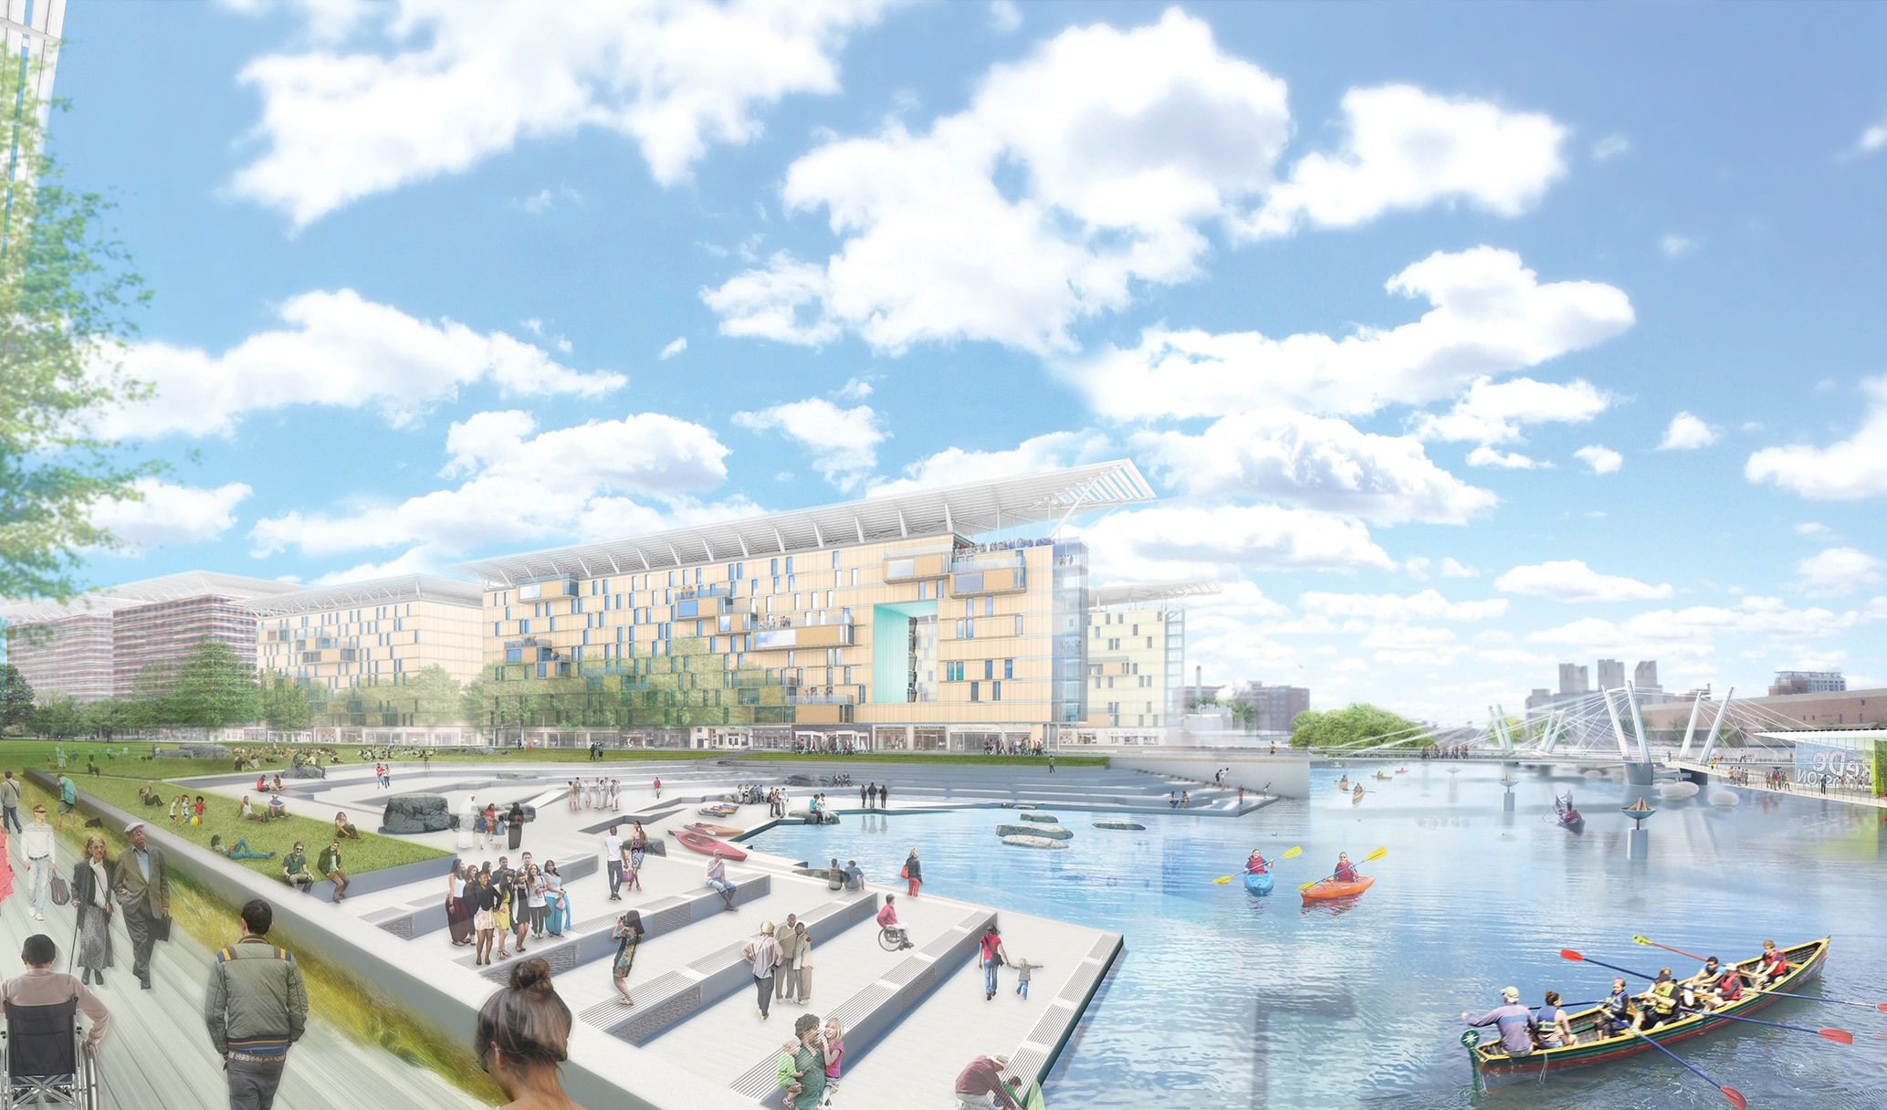
COSTAS PROTEGIDAS
ESTRATEGIAS PROPUESTAS:
Investigar las opciones para la protección contra inundaciones y urbanizaciones inteligentes
Notes:
Developing neighborhood plans
District level flood protections i.e. shoring up New Charles Dam.
Zoning/building requirements that promote development adding to current and not limiting future flood responses

Slide 24
INFRAESTRUCTURA RESISTENTE
ESTRATEGIAS PROPUESTAS:
Desarrollar estándares preparados para el cambio climático para la planificación y el diseño
Instalar redes de energía en los vecindarios
Trabajar con la naturaleza para reducer los efectos
Notes:
Coordinating plans across infrastructure providers including CRB strategies
Decentralize energy supply per micro grids

Slide 25
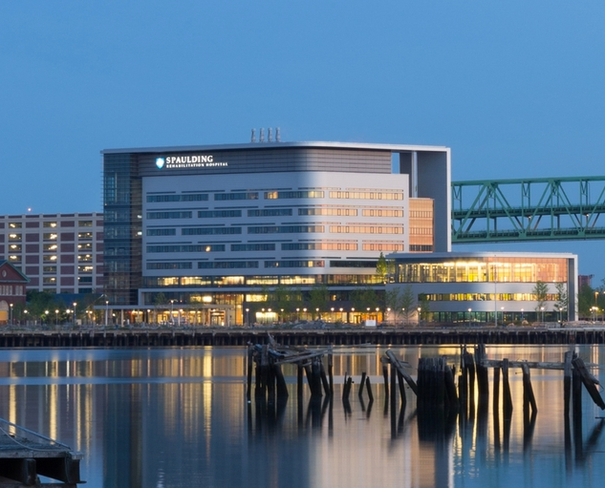
EDIFICIOS ADAPTADOS
ESTRATEGIAS PROPUESTAS:
Actualizar los códigos de zonifación y construcción, explorar readaptaciones.
Preparar los edificios con mayor riesgo.
Promover el acceso al seguro.
Notes:
Spaulding Medical Clinic already provides living example of what’s possible.
In addition to CRB friendly zoning and building codes.....
Retrofitting critical given most of Boston’s buildings exist already

Slide 26
PROMOVER LOS PUNTOS DE ACCIÓN DE CLIMATE READY BOSTON
DISCUSIÓN
Herramientas avanzadas para la toma
de decisiones
Comunidades preparadas y conectadas
Costas protegidas
Infraestructura resistente
Edificios adaptados
¿QUÉ OPORTUNIDADES EXISTEN PARA ADOPTAR LISTAS PARA LOS CAMBIOS CLIMÁTICOS?
¿QUÉ TIPO DE COLABORACIÓN SE NECESITA DE PARTE DE LA CIUDAD Y DEMÁS SOCIOS?
Notes:
Shift to dialogue/input mode
What existing efforts can be leveraged? Collaborations needed.

Slide 27
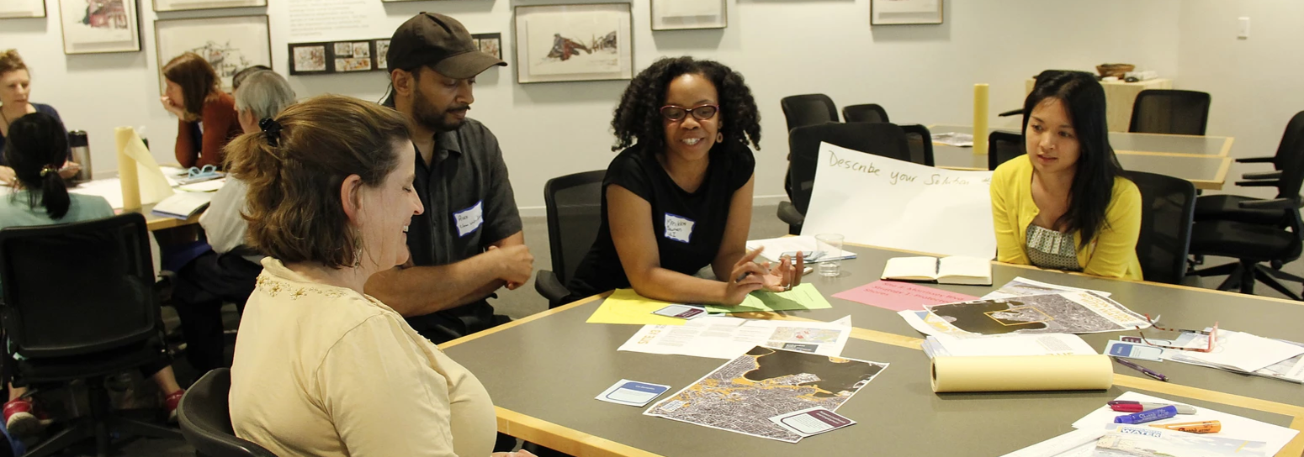
Unirse a un equipo del vecindario www.greenovateboston.org
Contribuir a la visión del future de Boston www.imagine.boston.gov
¿QUÉ PUEDE HACER USTED?
HACER PARTE DEL PLAN
CLIMATE READY BOSTON
Notes:
Resilience strategies are part of Imagine 2030 Boston still accepting public comment.
*Greenovate following up re: neighborhood resilience strategies.
CAN GET MORE SPECIFIC re: issues relevant per sector/issue i.e. Renew Boston
Refer to process doc re: dialogue steps

