Slide 1
613 MASS AVE REAR DECK UPGRADES

Slide 2
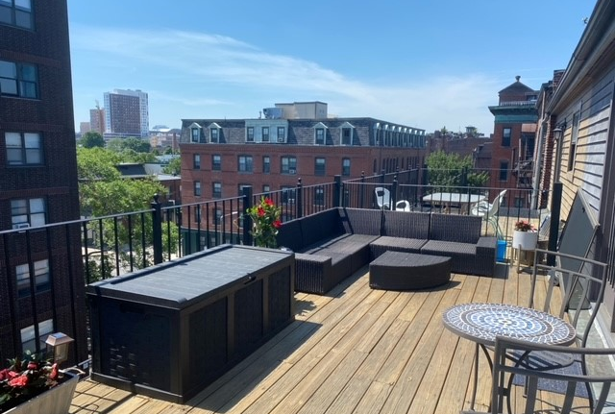
NO WORK TO BE DONE ON HANDRAILS JUST REPLACE EXISTING AGED WOODEN DECK BOARDS WITH TREX COMPOSITE. INSTALL A BLACK METAL POLE IN EACH CORNER OF THE DECK TO SUPPORT STRING LIGHTS. THE POLES ARE SEASONAL FOR USE DURING SUMMER MONTHS.
EXISTING CONDITIONS

Slide 3
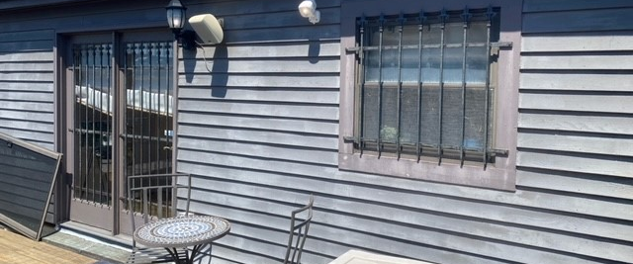
DUE TO SAFETY CONCERNS (DECK IS ACCESSIBLY FROM STREET LEVEL DUE TO STAIRS) WE WILL INSTALL NEW DOORS, SAME SIZE AND STYLE MADE OF FIBREGLASS AND REINSTALL THE BARS MORE SECURELY. REPAINT ONLY FOR WINDOW BARS

Slide 4
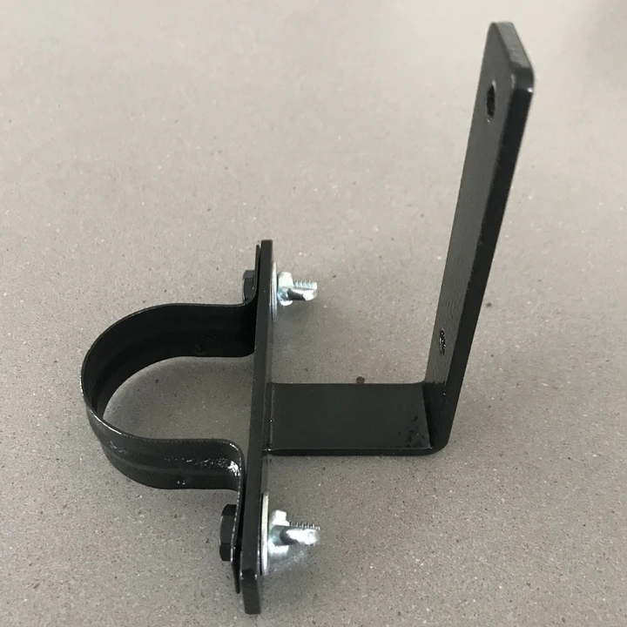
BELOW IS AN EXAMPLE OF WHAT THE SEASONAL POLES WILL LOOK LIKE PLEASE NOTE THE BRACKETS WILL BE ATTACHED TO THE EXISTING RAILINGS

Slide 5
DECKING – WE ARE REPLACING THE EXISTING WOODEN DECK BOARDS WITH TREX SELECT COMPOSITE DECKING

Slide 6
THE DECK IS NOT VISIBLE FROM THE FRONT JUST FROM THE REAR AND SIDES

